Slide 1

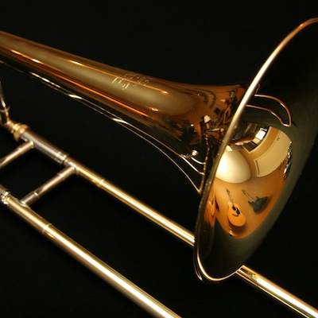
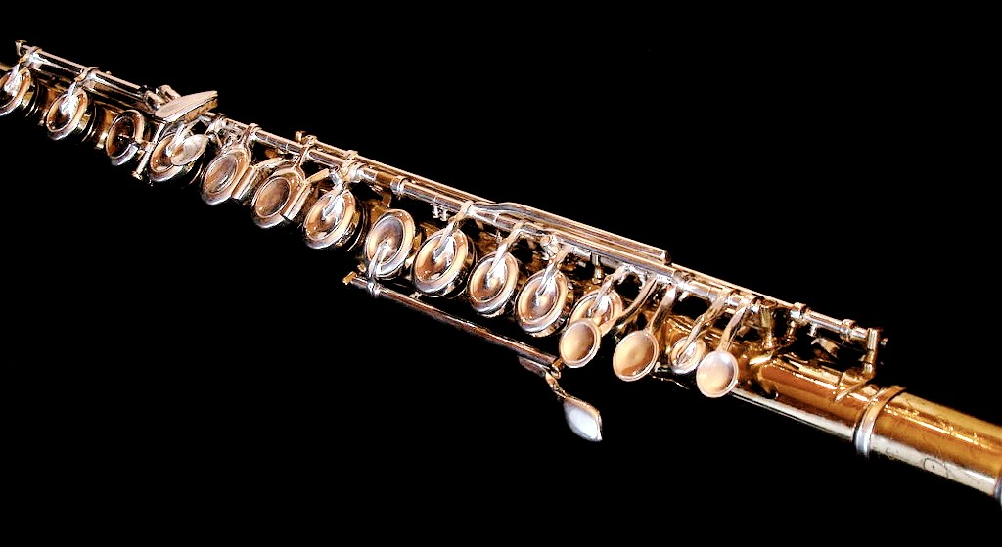
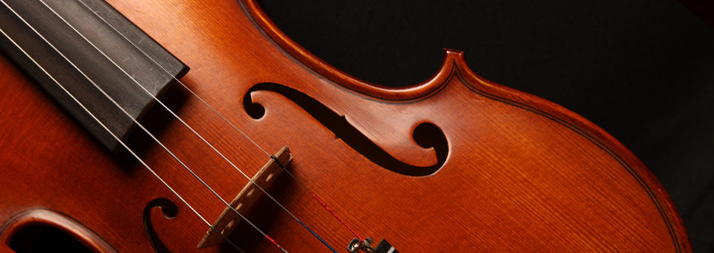
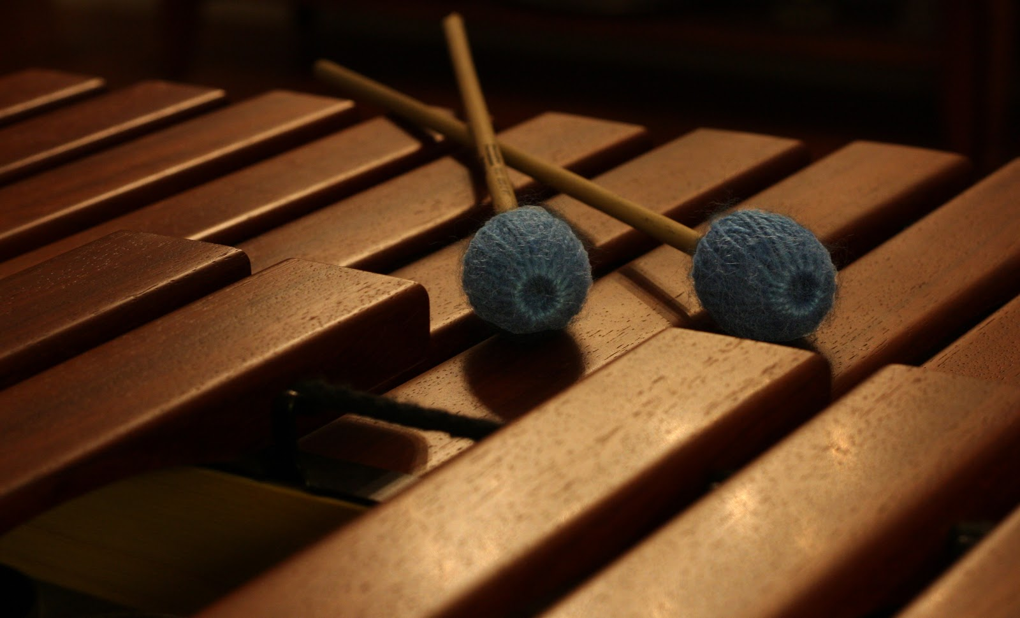


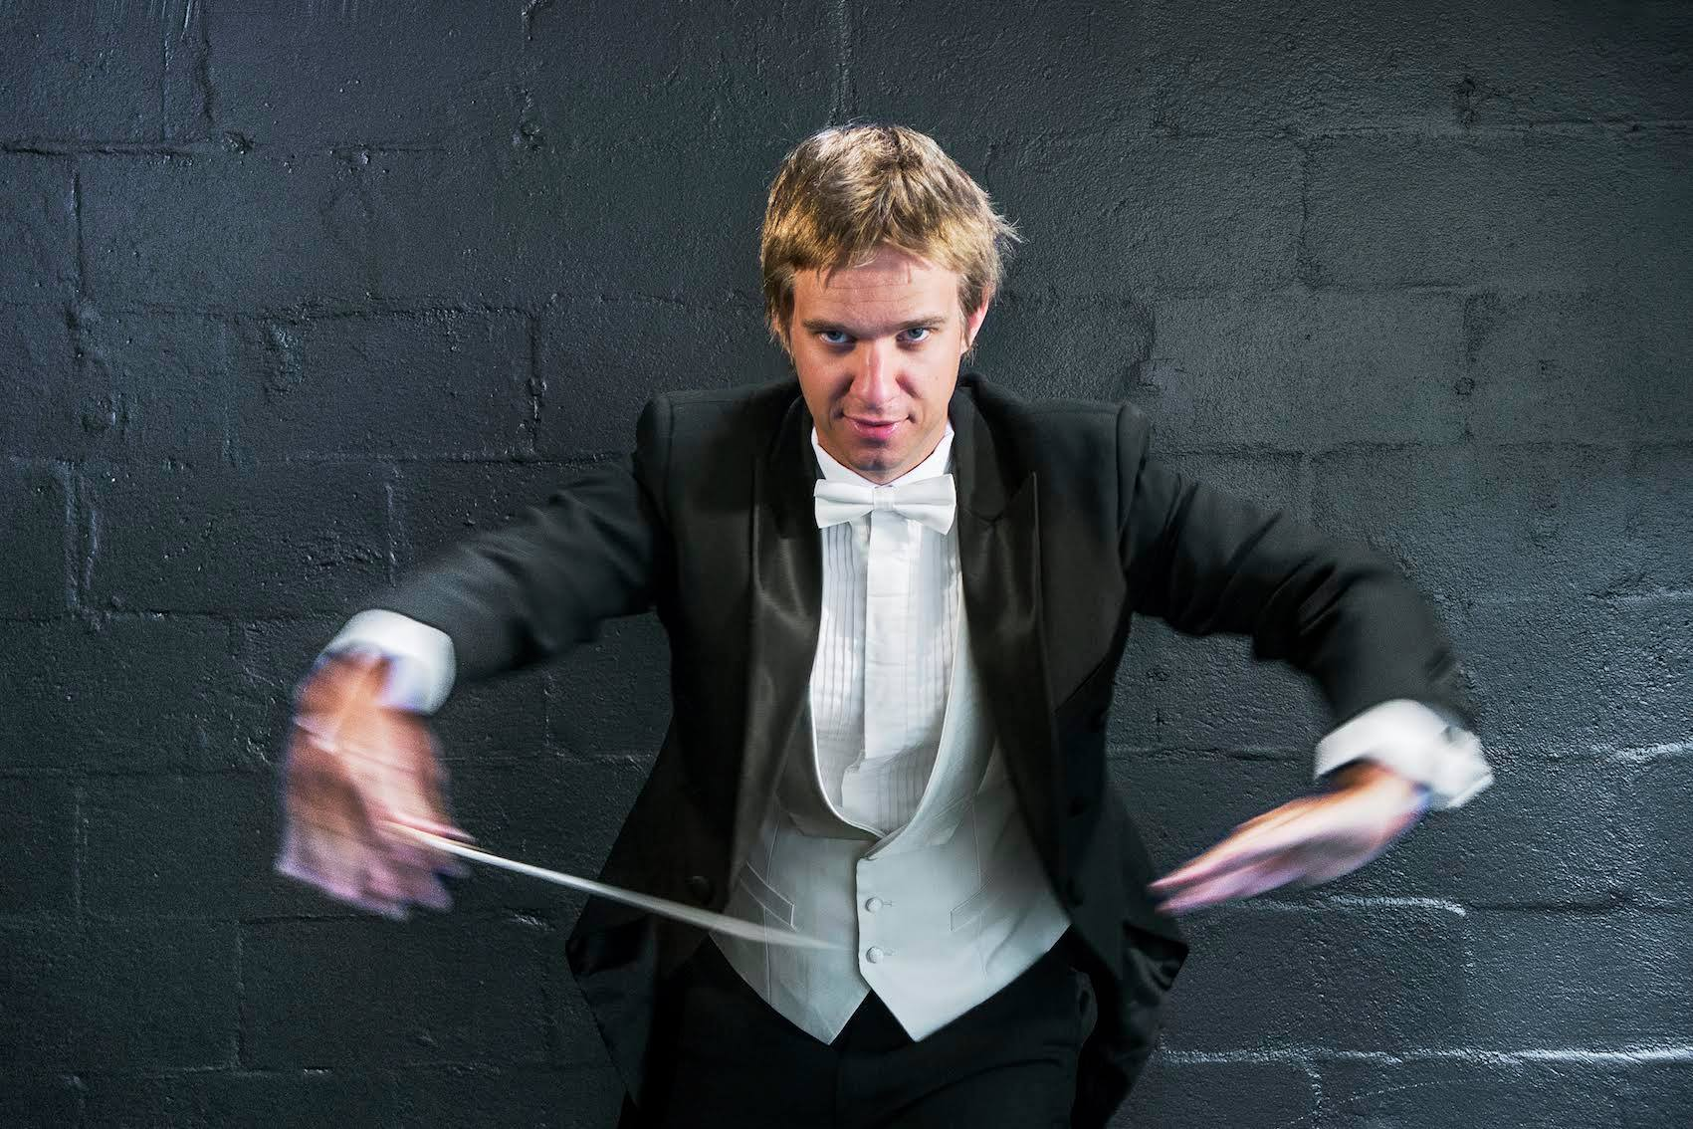

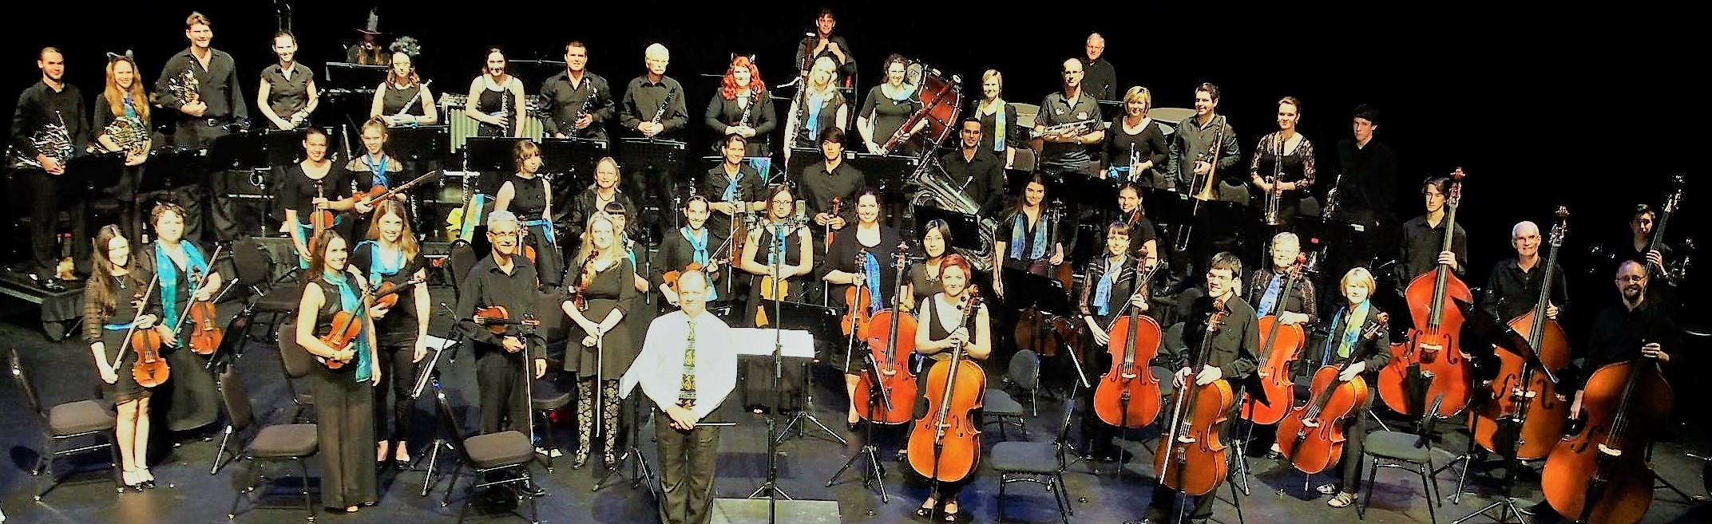






Barrier Reef Orchestra
Search
Home
Artists & Events
About Us
Support Us
Contact Us
Email Us
brotownsville@gmail.com
Barrier Reef Orchestra
Barrier Reef Orchestra
Players
Barrier Reef Orchestra
PO Box 576
Townsville Qld 4810
p: +61 (0) 747 222 789
Home
Since the early nineties many people and groups have contributed to the orchestra's growth and development. This has allowed the orchestra to be recognised as a significant contributor to this performance genre. Local and international talent, who were once invited, are now contacting us and asking if they can return and perform before our adoring followers which have been amassed since the inception of the Barrier Reef Orchestra.
Performances each year include Orpheus Strings, Pandanus Winds, Kingfisher Trio, and the Centenary Concert, as well as, the yearly highly acclaimed Australian Concert Vocal Competition. Many of the winners and participants go on to become world renowned. Fortunately, they remember us as being part of their journey, and in doing so, we benefit from this connection by being privileged to have them return to our stage to delight audiences of all ages. These wonderful artists and musicians never forget the support we offered when they were starting their journey into the national and international arena. As such, they reward our loyal followers of music, by gracing us with their musical prowess, whether that be through vocal delights or instrumental pleasures that leave us wanting more.
Major Sponsor Sponsors Concert Partners

Slide 2
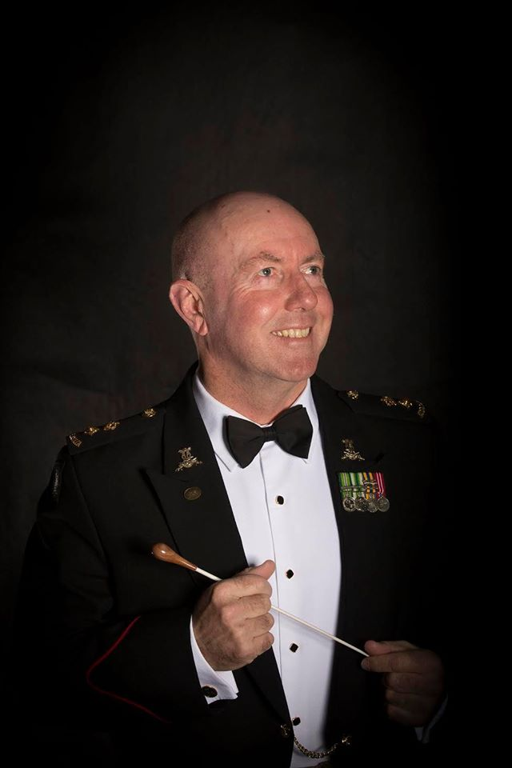
Barrier Reef Orchestra
Search
Home
Artists & Events
About Us
Support Us
Contact Us
Email Us
brotownsville@gmail.com
Barrier Reef Orchestra
Barrier Reef Orchestra
Players
Barrier Reef Orchestra
PO Box 576
Townsville Qld 4810
p: +61 (0) 747 222 789
About Us
The Barrier Reef Orchestra is a product of North Queensland Ensembles Inc which is an Incorporated Association registered in the State of Queensland.
In the late nineties, Townsville musicians, arts workers and a group of people who had a love for music realised the potential for developing a community-based Orchestra. As a result, a weekend workshop was arranged in 2000 and musicians were invited to participate the result was the birth of the Barrier Reef Orchestra.
In a typical year the Barrier Reef Orchestra, under the auspices of North Queensland Ensembles Inc, performs three times generally with a guest conductor and occasionally with other performing groups. Smaller ensembles, all utilising players from the Orchestra, regularly give concerts — Orpheus Strings, Pandanus Winds, Kingfisher Trio, Centenary Concert Band and the Barrier Reef Chamber Orchestra.
During the next few years the Orchestra performed with the comedy-duo Scared Weird Little Guys in Score, Townsville City Council’s Last Night of the Proms and A Christmas Carol.
The advancement of the Barrier Reef Orchestra has been profound over the years:
+2006 +2007 +2008 +2009 +2010 +2011 +2012 +2013
+2014 +2015 +2016
Major Sponsor Sponsors Concert Partners

Slide 3
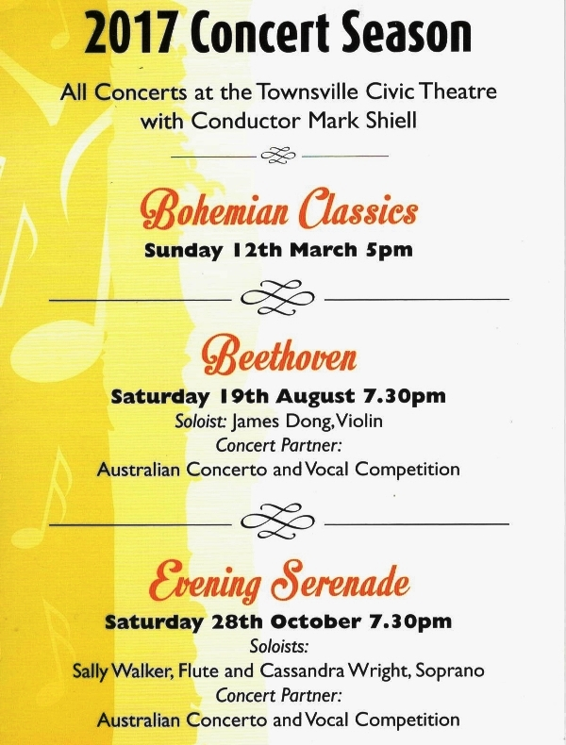
Barrier Reef Orchestra
Search
Home
Artists & Events
About Us
Support Us
Contact Us
Email Us
brotownsville@gmail.com
Barrier Reef Orchestra
Barrier Reef Orchestra
Players
Barrier Reef Orchestra
PO Box 576
Townsville Qld 4810
p: +61 (0) 747 222 789
Our contact details are:
Phone: +61 (0) 747 222 789
Email: brotownsville@gmail.comb
Postal Address: Barrier Reef Orchestra
PO Box 576
Townsville Qld 4810
Major Sponsor Sponsors Concert Partners

